Slide 1
Cloud Computing
Introduction

Slide 2
What is cloud computing
Cloud computing is a way to use technology services like- (storing files running software) over the internet instead of relying on your own computer or physical hardware

Slide 3
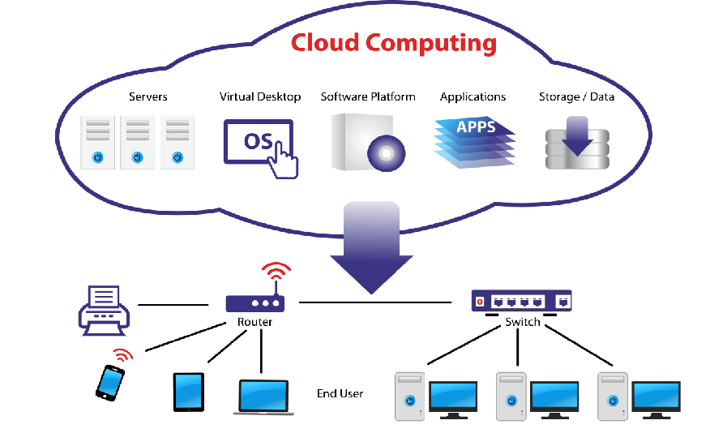
Cloud computing work

Slide 4
Uses of cloud computing
Data storage
Data backup
Big data analytics
Software testing
Cost saving

